Slide 1
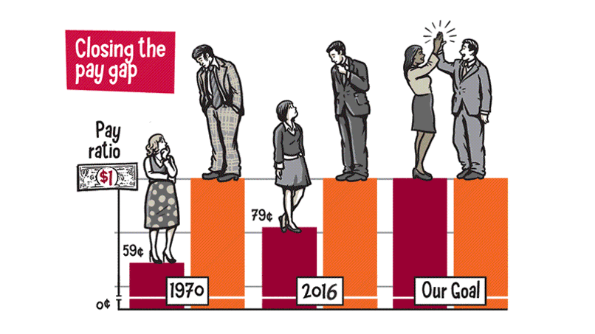
Accounting for Wage Inequality between Genders
By: Pujan Thakrar and Mark Vandre

Slide 2
Introduction
Fast Facts
Supply of women in the labor force has increased over time.
On average, women make 80 cents for every dollar a man makes.
The wage gap has been shrinking over time.
Economic questions
What is the relationship between relative supply of female labor and relative wages?
Is the change in the wage bill mainly due to between industry or within industry changes?
Do these results differ for full-time and part-time workers?

Slide 3
Data
The American Community Survey: 2000 - 2017
Contains relevant information regarding work, pay, and demographics
Preprocessing
Outcome variable (relative wage) was composition adjusted using hours worked
Comparisons were made for people in their prime working years (25 to 54)
The log-difference of female workers to male workers was calculated as an instrument for the canonical model
Three separate versions of the same data were created for comparisons

Slide 4



Models
The Canonical Model

Slide 5

Models
The Shift-Share Model
Total change in wage bill share
Between Industry change in wage bill share
Within Industry change in wage bill share

Slide 6
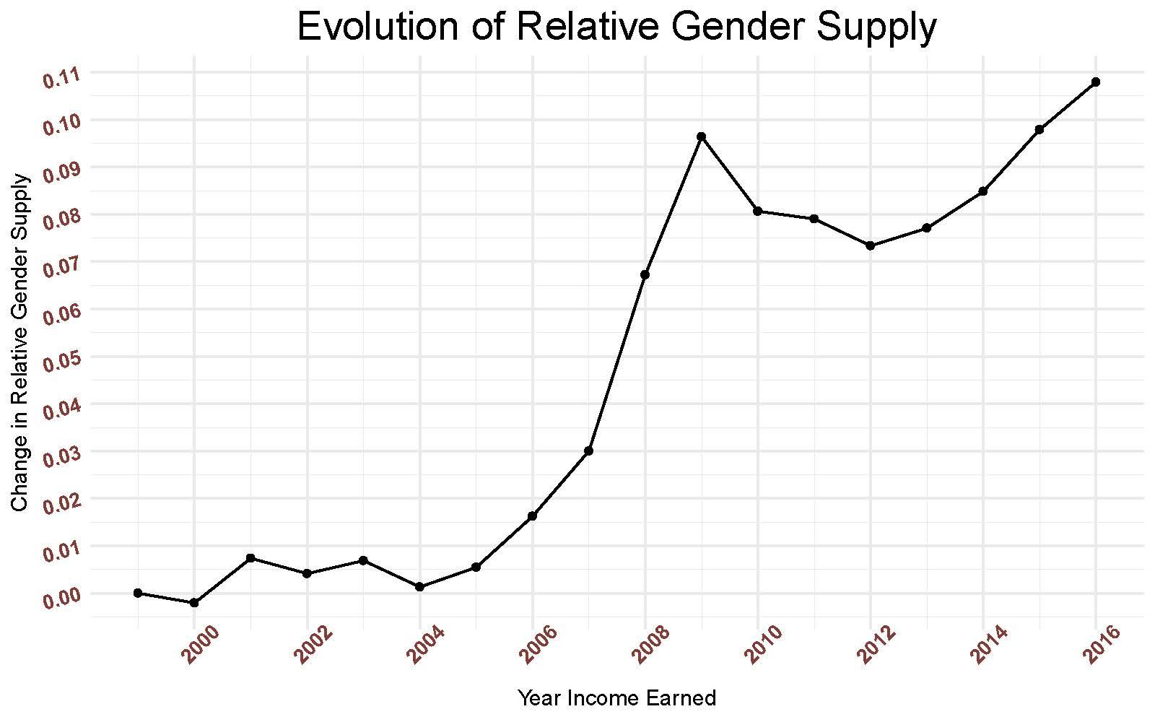
Evolution of Relative Supply of Female Workers

Slide 7
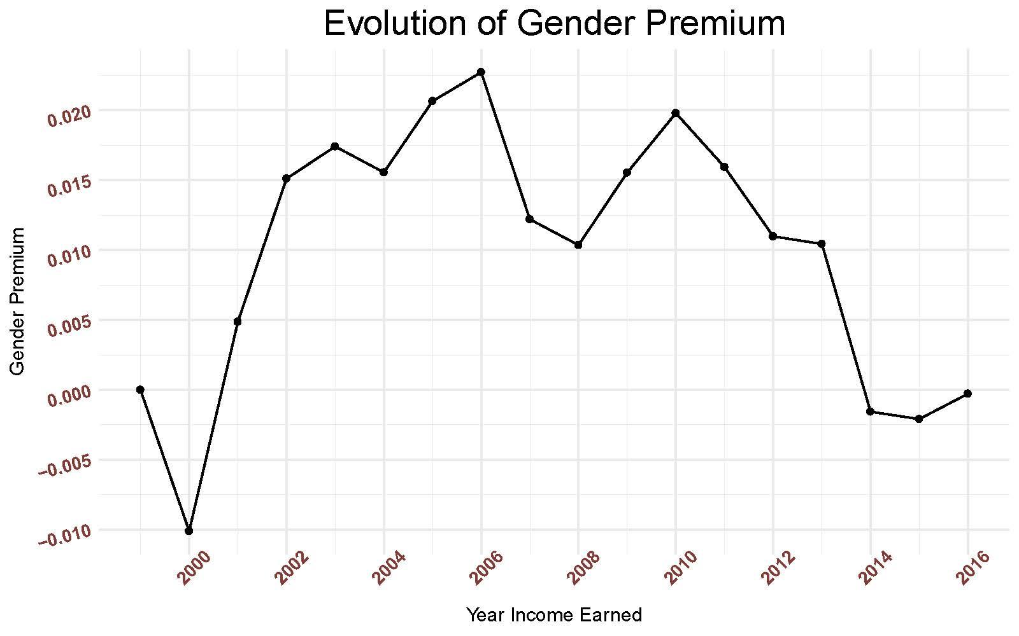
Evolution of the Gender Premium

Slide 8
Evolution of the Gender Premium
Gender premium was increasing until 2006.

Slide 9
Evolution of the Gender Premium
Gender premium was increasing until 2006.
Premiums fell during the Great Recession.
Start of Recession

Slide 10
Evolution of the Gender Premium
Gender premium was increasing until 2006.
Premiums fell during the Great Recession.
Recent significant decline in wage premium starting in 2014.
Start of Recession

Slide 11
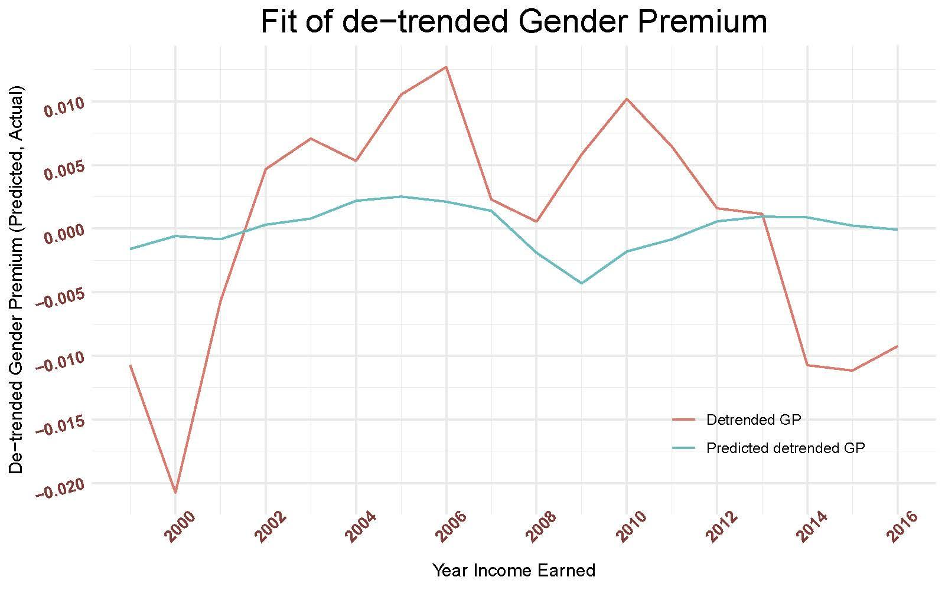
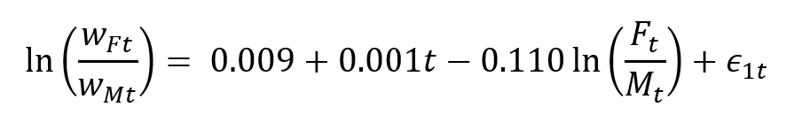
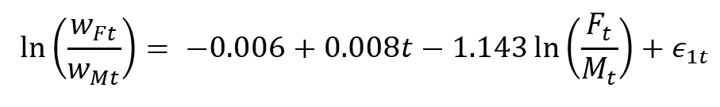
Relationship between Relative Supply and Wages
Ordinary Least Squares Regression Estimates
IV Regression Estimates

Slide 12
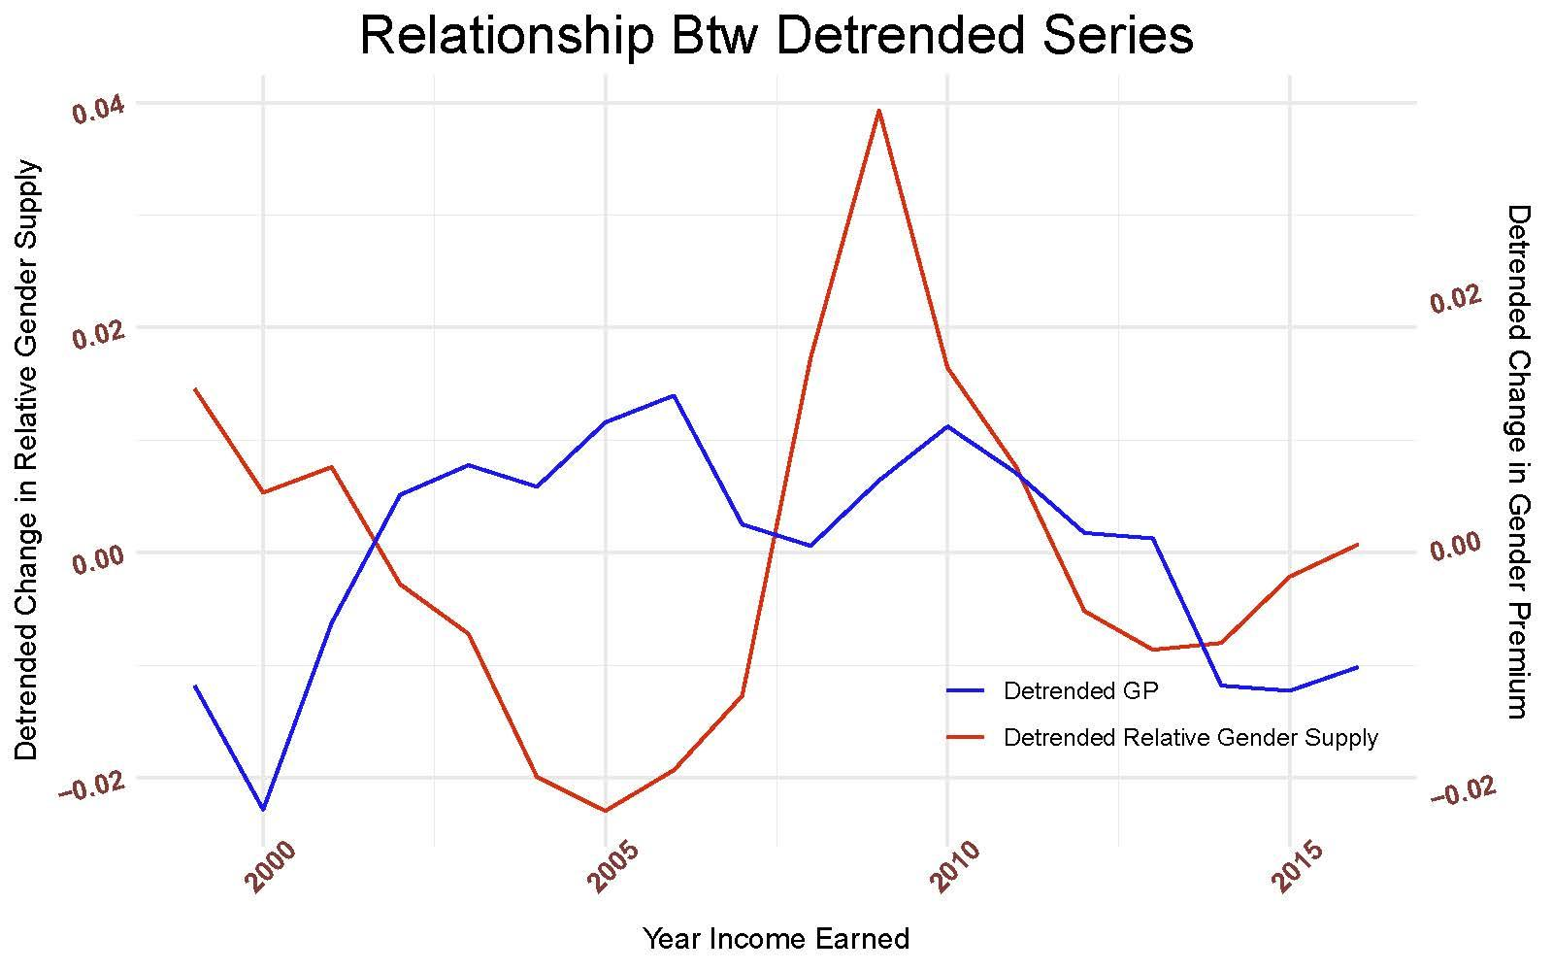
Relative Supply and Wages
Start of Recession

Slide 13

Shift-Share Decomposition
Female wage bill share changes 2.9 percentage points
Between industry accounts for 2 percentage points of the change in the wage bill
Within industry accounts for 0.9 percentage point of the change in the wage bill

Slide 14

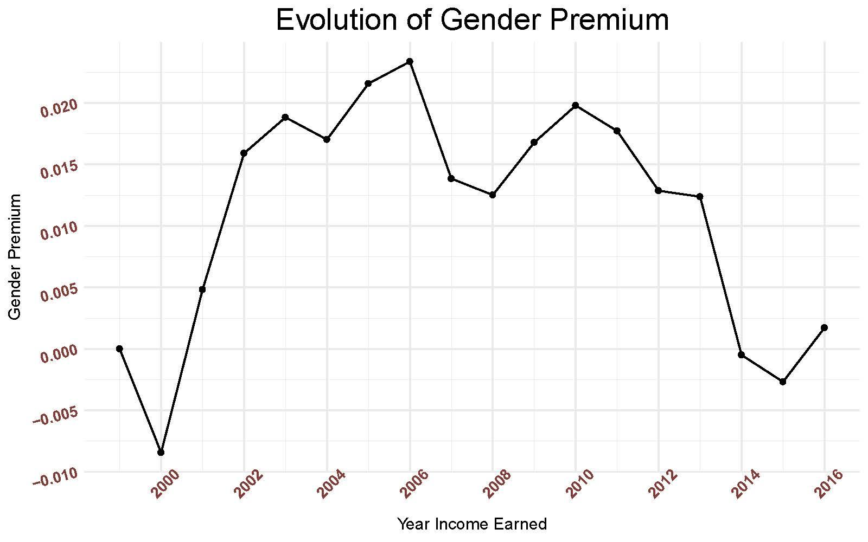
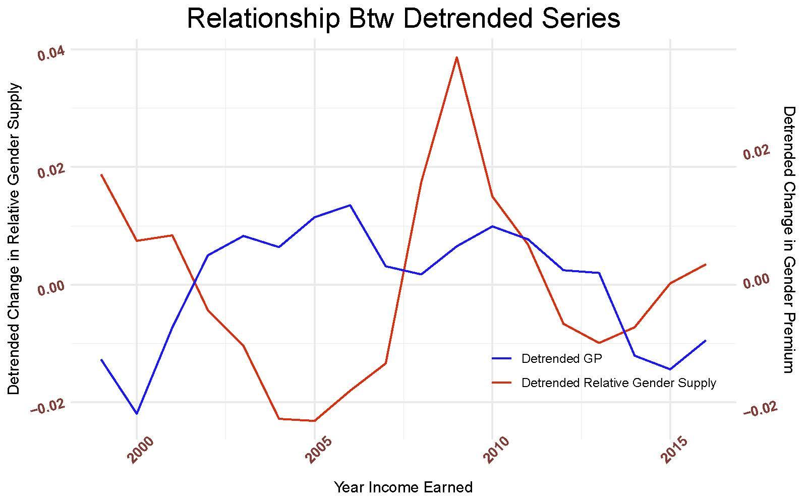
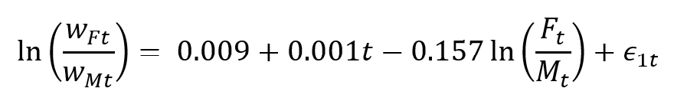
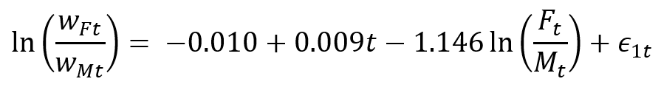
Full-Time Results
OLS Regression Estimates
IV Regression Estimates
Full-time Female wage bill share changes 3.1 percentage points
Between industry accounts for 2 percentage points of the change
Within industry accounts for 1.1 percentage points of the change

Slide 15
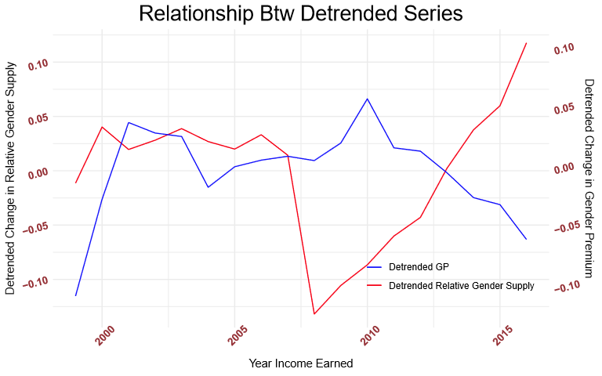
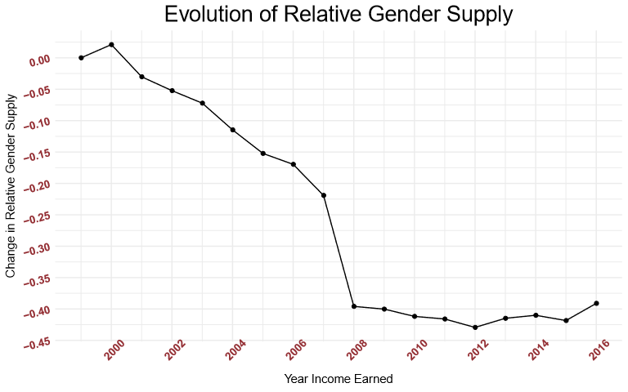
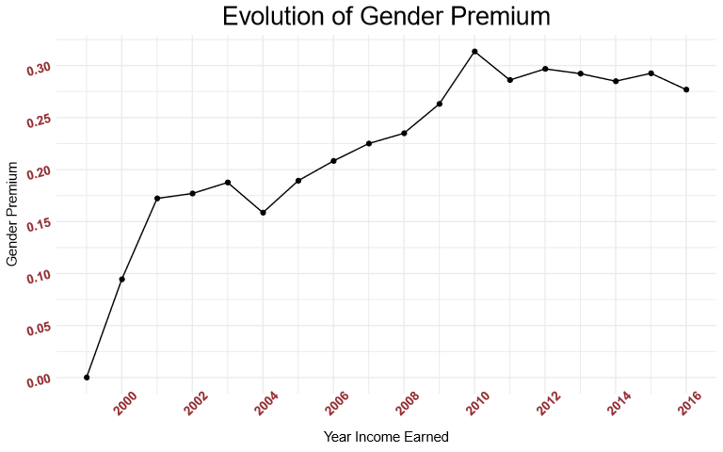


Part-Time Results
OLS Regression Estimates
IV Regression Estimates
Part-time Female wage bill share changes -0.6 percentage points
Between industry accounts for 1.5 percentage points of the change
Within industry accounts for -2 percentage points of the change

Slide 16
Future Work & Conclusion
It seems clear the Financial Crisis and Great Recession spurred an incredible increase in the relative supply of female workers, generally.
This drastic increase in relative supply may explain a large portion of the decline in relative wages paid to female workers back to near-1999 levels.
While these results are interesting, there may be a better framework for analyzing this trend.
Future work could perhaps elucidate a better model for estimating gender-specific relative wage changes.

